Slide 1

Customer Churn Descriptive and Predictive Analysis
Minh Nguyen Ngoc Tue
December 2023

Slide 2

Presentation Outline
Data Overview
Data Exploration
Customer Churn Prediction

Slide 3
Data Overview

Slide 4
Data Overview
Dataset
Customer info
CustomerID
Gender, Married, Number of Dependents
Services
Phone Service
Revenue
Internet Service
Multiple Lines
Internet Type
Device Protection Plan
Online Security, Backup
Premium Tech Support
Streaming TV, Movies, Music
Unlimited Data
Number of Referrals, Offer
City, Zip Code
Contract, Paperless Billing, Payment Method
Monthly Charge
Total Charges
Total Refunds
Total Extra Data Charges
Total Long Distance Charges
Customer Status, Churn Category, Churn Reason
Avg Monthly Long Distance Charges
Avg Monthly GB Download
Age, Latitude, Longitude, Tenure in Months
Total Revenue
For classification
Continuous variable
Categorical variable

Slide 5
Data Exploration

Slide 6
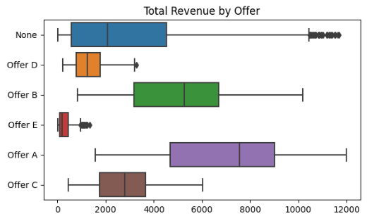
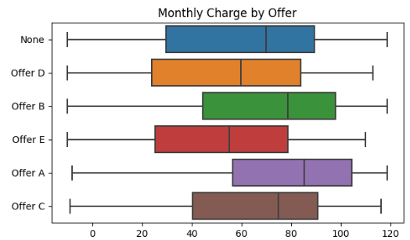
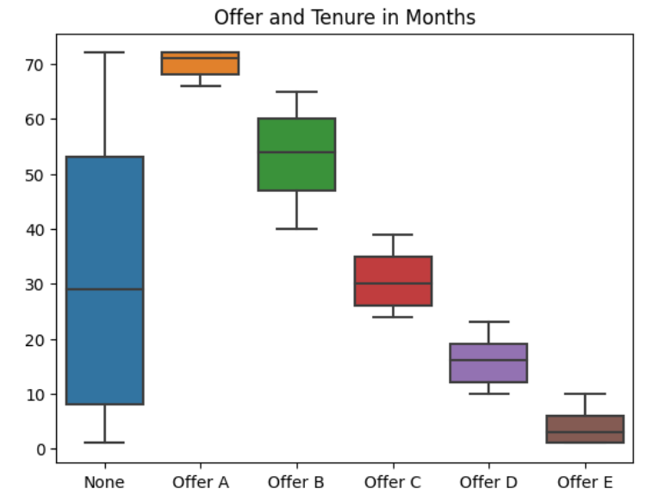
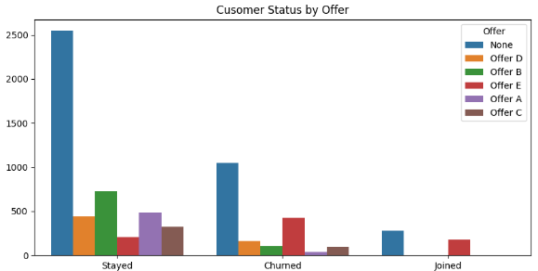
Data Exploration - Offer types
Offer E is the least performing offer & also customers churned are also from Offer E.
Company should either discontinue or make changes to make this offer more attractive.
Notes:
Box plot

Slide 7
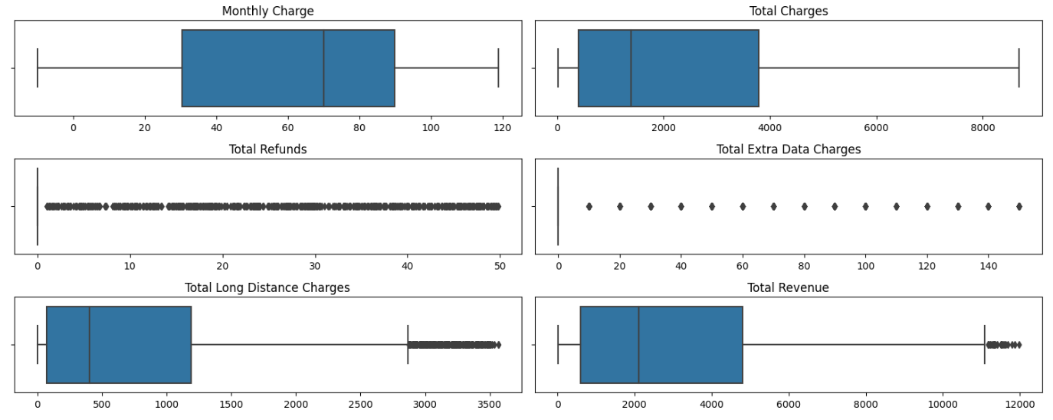
Data Exploration - Revenue Streams
Total revenue is based on total charges & total charges are mainly contributed by the long-distance charges.
Total refunds & extra data charges are very low.

Slide 8
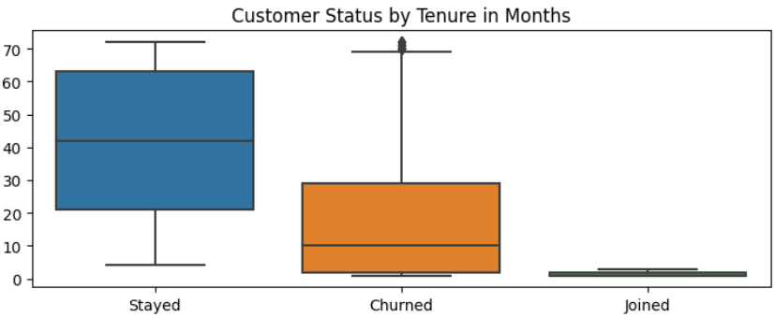
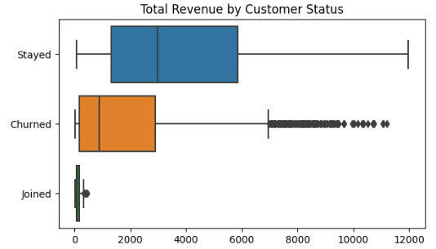
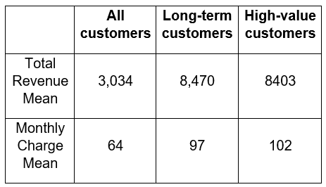
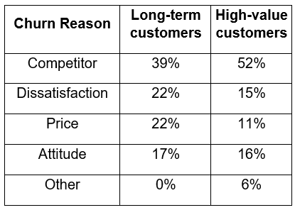
Data Exploration – Churn reason
The company is losing its revenue mainly due to competitor's strategy, dissatisfaction & attitude of the company
Company should conduct a thorough analysis of competitors' services, pricing models, and customer satisfaction levels.

Slide 9
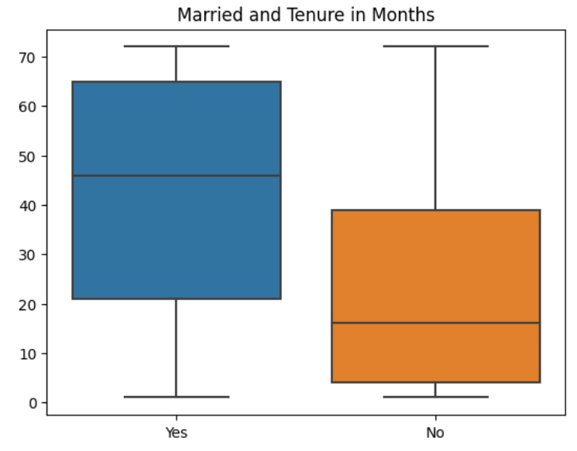
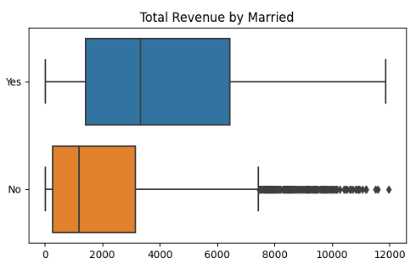
Data Exploration – Married/Single
The company is generating more revenue from married people & the tenure of the contract is also more
as compared to the single people.

Slide 10
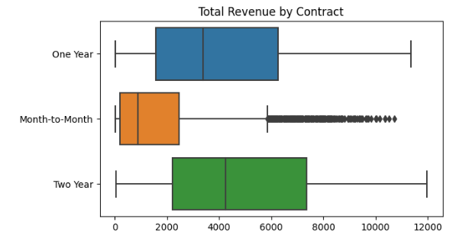
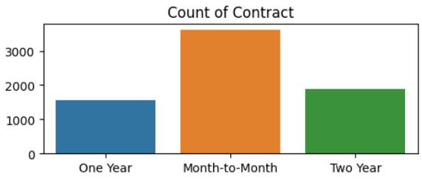
Data Exploration – Contract types
The maximum number of contracts are from customers who use services on a monthly basis,
The total revenue from monthly contracts is lesser than all other types of contracts.
The company should establish open communication channels to gather feedback from the customers who use monthly services & use this feedback to continuously refine and improve the services and promotions offered to meet their evolving needs.

Slide 11
Customer Churn Prediction

Slide 12

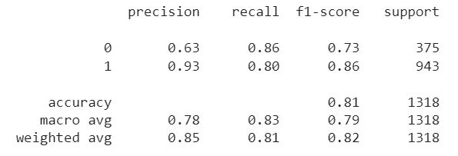
Logistics Regression
Version of data
- unscaled and unbalanced data - scaled and unbalanced data - unscaled and balanced - scaled and balanced
In Logistic Regression, scaled and balanced data give the best performance
accuracy_score: 81%
balanced_accuracy_score: 83%
confusion_matrix
classification_report

Slide 13


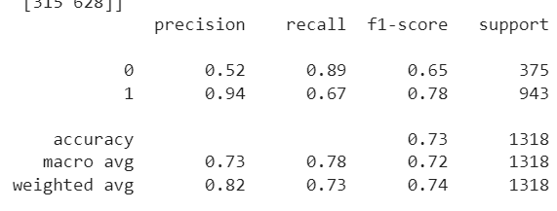
Decision Tree
Version of data | Parameter combination
- unscaled and unbalanced data - scaled and unbalanced data - unscaled and balanced - scaled and balanced | - max_depths: 1-21 - criterions: “gini”, “entropy”, “log_loss”
In unscaled and balanced data, the combination of max_depth=3, criterion=entropy, give the best performance
accuracy_score: 73%
balanced_accuracy_score: 78%
confusion_matrix
classification_report

Slide 14


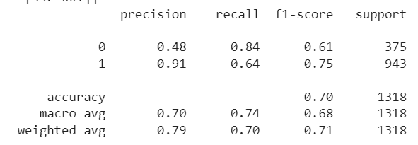
Gaussian Naïve Bayes
Version of data
- unbalanced data - oversampling data - undersampling data
In Gaussian Naive Bayes, oversampling data gives the best performance
accuracy_score: 70%
balanced_accuracy_score: 74%
confusion_matrix
classification_report

Slide 15


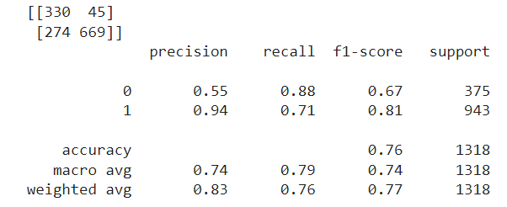
K Nearest Neighbours
Version of data | Parameter combination
- scaled and unbalanced data - scaled and balanced data | - n_neighbors: 1-11 - metrics: "minkowski","manhattan","euclidean","canberra" - weights: "uniform","distance"
In scaled and balanced data, the combination of n=8, m=canberra, w=uniform give the best performance
accuracy_score: 76%
balanced_accuracy_score: 79%
confusion_matrix
classification_report

Slide 16

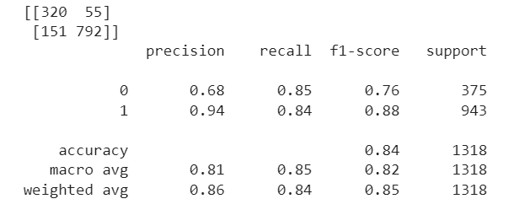
Random Forest
Version of data | Parameter combination
- unscaled and unbalanced data - scaled and unbalanced data - unscaled and balanced data - scaled and balanced data | - max_depths: 1-21 - metrics: "gini", "entropy", "log_loss"
In unscaled and balanced data, the combination of max_depth=8, citerion=entropy give the best performance
accuracy_score: 84%
balanced_accuracy_score: 85%
confusion_matrix
classification_report

Slide 17
Evaluation Principle
Precision of Churned
and/or
Recall of Churned
If low
If low
More customers who were predicted to churn but stayed
More customers who were predicted to stay but churned
High cost of retaining customers who stayed anyway
High cost of losing existing customers
Less costly
Very costly
High Recall of Churned and Acceptable Precision of Churned
Notes:
The company wants to correctly predict which customers will churn so that they can take timely actions to retain those customers. => High Recall and Precision of Churned => Cannot both because there is usually a trade-off
Low Recall of Churned means there are more customers who were predicted to stay but churned => cost of losing existing customers is high => very costly, because customers often stay with the same provider for years in the Telecom Industry (Lifetime Value)
Low Precision of Churned class means there are more customers who were predicted to churn but stayed => the company would waste money (special offers, discounts, etc.) to retain more customers who were predicted to churn but stayed anyway => less costly, because cost is way lower than the cost of losing existing customers. => need high Recall of Churned class but still maintain an acceptable Precision of Churned class

Slide 18
Conclusion
Model | Accuracy score | Balance accuracy score | Precision of Churned | Recall of Churned | F1 | Ranking
Logistics | 81.49% | 82.81% | 62.77% | 85.87% | 72.52% | 2
KNN | 75.80% | 79.47% | 54.64% | 88.00% | 67.42% | 4
Decision Tree | 73.07% | 77.96% | 51.54% | 89.33% | 65.37% | 3
GaussianNB | 69.58% | 74.00% | 48.00% | 84.00% | 61.00% | 5
Random Forest | 84.37% | 84.66% | 67.94% | 85.33% | 75.65% | 1
Recommendation:
Stop offer E which is a new offer (low Total Revenue) and only accept among new customers because it does not perform well (low Monthly Charge), and more people who churned when accepted this offer. Promote Offer A and B.
Promote Long Distance Service because Total revenue mainly comes from Total Charges and Total Long Distance Charge (Total Refunds and Total Extra Data Charges are small).
Improve competitiveness by researching about Competitors’ services and improving their own services because there are many long-term customers and high-value customers who churned, they have higher average Total Revenue and Monthly Charge than all customers, and most of them leaving because of Competitor, Dissatisfaction and Price
Promote for Married customers because they tend to stay longer and single customers and they generate more revenue.
Focus on converting monthly customers to yearly customers instead of acquiring new customers, and change in business strategy to generate more revenue from monthly customers, because yearly customers create more revenue and the company already have so many monthly customers.

